Slide 1
Introduction to Cryptocurrencies
Week 1
Ofir Cohen
Based on Aviv Zohar’s lectures

Slide 2
About me
Ofir Cohen
PhD student at The Hebrew University of Jerusalem
Research areas: Machine Learning and systems.
Came into the world of cryptocurrencies around 2020.
Reception hours: Weekly (on Zoom).

Slide 3
Everything you need is on moodle (slides, exercises, etc.)
Contact me: ofir.cohen7@mail.huji.ac.il

Slide 4
Course requirements
Weekly lectures:
3 hours a week
Mandatory attendance: you are allowed to miss at most 3 lectures.
Final grade:
Attendance – 10% of the grade
~5 Exercises – 40% of the grade
1-2 theoretical
4 programming
Submission in pairs
Final exam - 50% of the grade

Slide 5
Course requirements
What you need to know in order to succeed:
Algorithms, data structures
Basic probability
Cryptography helps but no deep understanding needed.

Slide 6
What is this course about?
What this course isn’t about?
Any investment advice
How money works
How decentralized cryptocurrencies work (theory and practice)
What are their weaknesses?
How can you attack them?
Can they scale?
Can they be made efficient?
How is privacy maintained?
How were they hacked?
What are the proposals to solve these problems?
What else will blockchain systems do?

Slide 7
Academic Honesty
Work you submit must be entirely your own.
Sometimes ChatGPT (or any other LLM) can harm you, use it wisely.
It is okay to consult with someone else on a problem and to discuss the solutions, as long as eventually you walk away and each person writes their own solution.

Slide 8
Today
A light introduction and an overview of the protocol
Later we start to extend & deep dive into different parts.
Some parts of the course are theoretical and mathematical, for example security analysis of Bitcoin.
Some are practical – deploying smart contracts on Ethereum, coding prototypes versions Blockchains and higher-level systems.

Slide 9
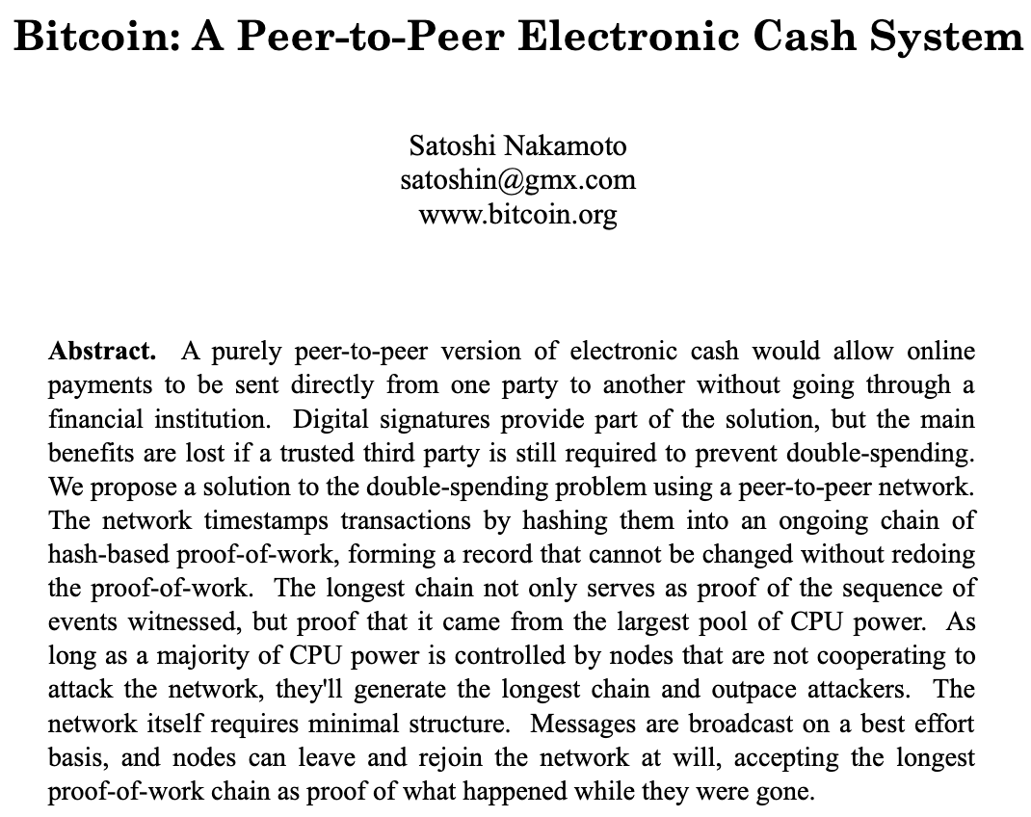
Back in 2008

Slide 10
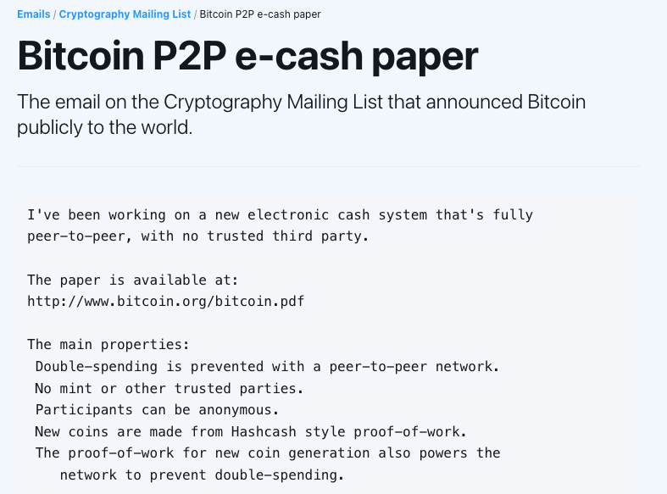
Notes:
https://www.bitcoin.com/satoshi-archive/emails/cryptography/1/

Slide 11
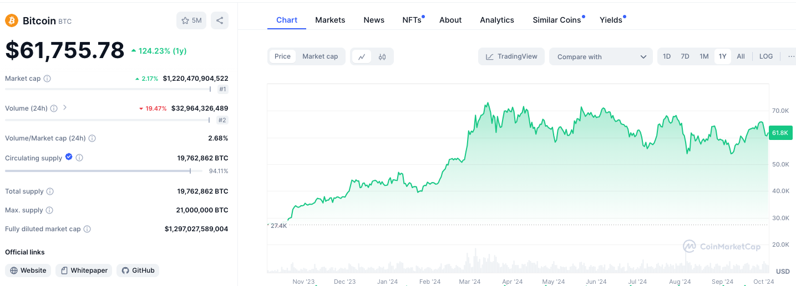

Slide 12
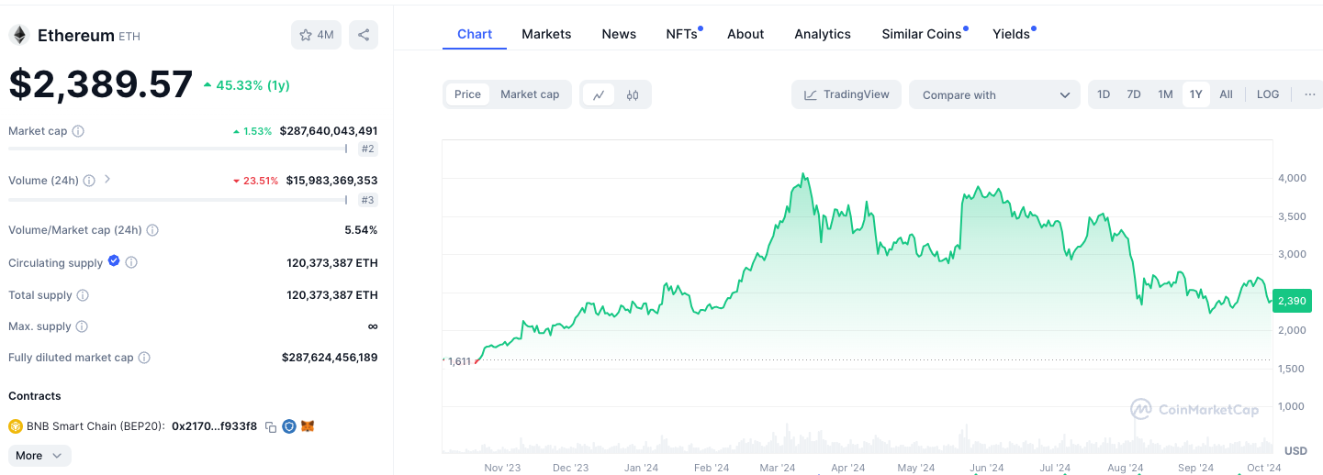

Slide 13

What is a blockchain?
Distributed Ledger
Data is replicated reliably
Some nodes might be malicious
(Byzantine fault tolerant)

Slide 14
Two types of blockchain systems
Private (Permissioned):
Known participants
“Classic” well studied setting
Public (Permissionless):
Open, anonymous
Cryptocurrencies

Slide 15
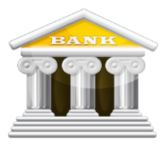


Conventional Banking system
Charlie: $800
Alice: $500
Bob: $900
Notes:
כשמדובר על שתי חשבונות תחת אותו בנק אז סה״כ צריך לעדכן את מצב החשבון לכל אחד (להוסיף לחשבון אחד ולהוריד מחשבון אחר)
מה קורה כאשר אליס תרצה להעביר כסף לצ׳רלי?

Slide 16
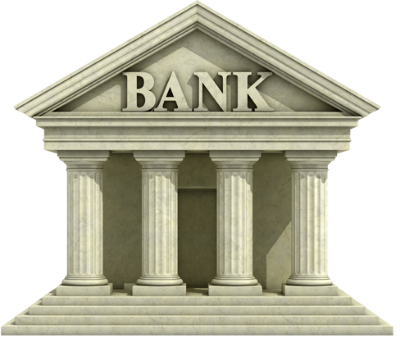
Conventional Banking system
The Central Bank
Poalim: $2Bn
Leumi: $1.5Bn
MT: $0.9Bn
Charlie: $800
Alice: $500
Bob: $900
Notes:
באופן פשטני, נבצע את ההעברה דרך בנק מרכזי שבו נעדכן את יתרות החשבון של בנק הפועלים ובנק לאומי.

Slide 17


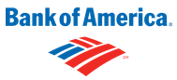
Conventional Banking system
Corresponding account

Slide 18

From decentralized to centralized
Digital Payments
Blue: 2
Red: 1
Bitcoin & similar currencies
Blue: 2
Red: 1
Blue: 2
Red: 1
Blue: 2
Red: 1
Blue: 2
Red: 1
Blue: 2
Red: 1
Blue: 2
Red: 1
Blue: 2
Red: 1
Blue: 2
Red: 1
Notes:
בבנק יחיד (ישות ריכוזית) יהיה רשום את הטרנזקציה שביצע הכחול אל האדום ומה מצב היתרה של כל אחד מהם.
כאשר אנחנו בעולם מבוזר אז יש לנו כמה ישויות ששומרות את הטרנזקציות שמתרחשות ברשת. אבל יכול להיות כמה קודקודים ״סוררים״ – רעים.

Slide 19
Blockchain
New Block
Hash
Hash
Hash
Hash
Another Node’s Block
Notes:
בלוקצ׳יין הוא רשימה של בלוקים שבתוכם אוסף של טרנזקציות (תשלומים בין 2 גורמים), לכל בלוק יש hash שזה מזהה ייחודי של הבלוק שמצביע על הבלוק הקודם בשרשרת.
ה-hash הוא תוצר של פונקציה קריפטוגרפית על הטרנזקציות של הבלוק + ה-hash של הבלוק הקודם

Slide 20
Alternative “histories”
The rules of Bitcoin’s consensus:
Intuition 1: Extending a chain = “voting” in favor of it
Nodes adopt the longest chain & extend it
Quickly send blocks to all nodes
Make block creation hard (via computational “puzzles”)
Intuition 2: “winner takes all” dynamics
Intuition 3: Attackers have limited voting power
Notes:
כדי שתהיה ״שפה משותפת״ בין כל הקודקודים ברשת שהם יסכימו על הבלוקצ׳יין צריך:
הקודקודים יאמצו את השרשרת הארוכה ביותר ויעבדו עליה
כאשר קודקוד מסוים בנה בלוק אז הוא ישלח במהירות לשאר הקודקודים ברשת
יצירת הבלוק תהיה ״קשה״

Slide 21





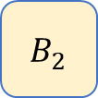

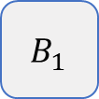




Make block creation hard (once every 10 minutes) via computational “puzzles”
Send blocks to all
Adopt (conflicting) blocks iff they make up a longer chain
A
$${ B}_{1}$$
C
A
$${ B}_{1}$$
C
A
$${ B}_{1}$$
C
A
$${ B}_{2}$$
$${ B}_{1}$$
C
A
$${ B}_{1}$$
C
A
$${ B}_{1}$$
C
A
$${ B}_{1}$$
$${ B}_{2}$$
C
A
$${ B}_{1}$$
C
A
$${ B}_{1}$$
C
$$B_{2}$$

Slide 22
The Double-Spend Attack
Main theorem [Satoshi Nakamoto]
Attacker controls < 50% of compute power
We can be safe.
The probability of block replacement decreases exponentially fast as blocks are added to chain.
Nodes can send blocks quickly

Slide 23

Incentives
Hash
+ minted coins
1MB size limit (DOS prevention)
Pay nodes for work (makes network large & secure)
“Mining”

Slide 24
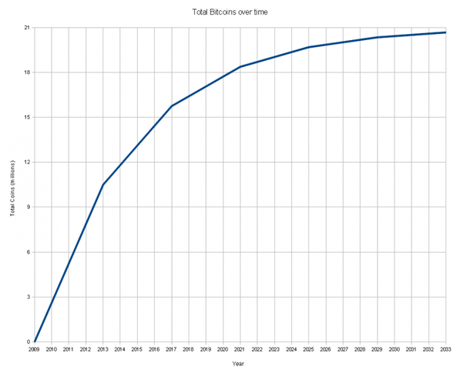
We are here!
3.125 BTC / block

Slide 25
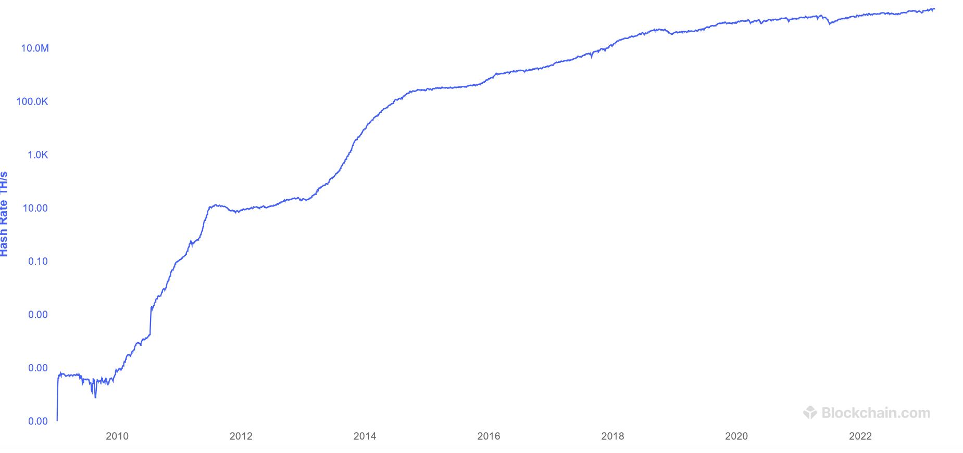

Slide 26
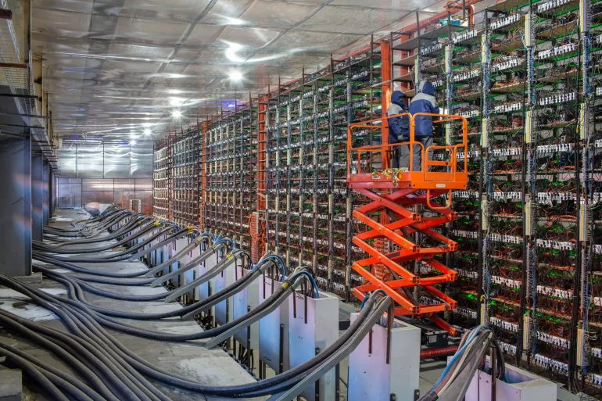
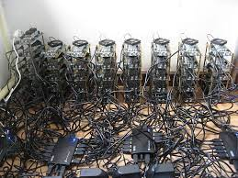

Slide 27
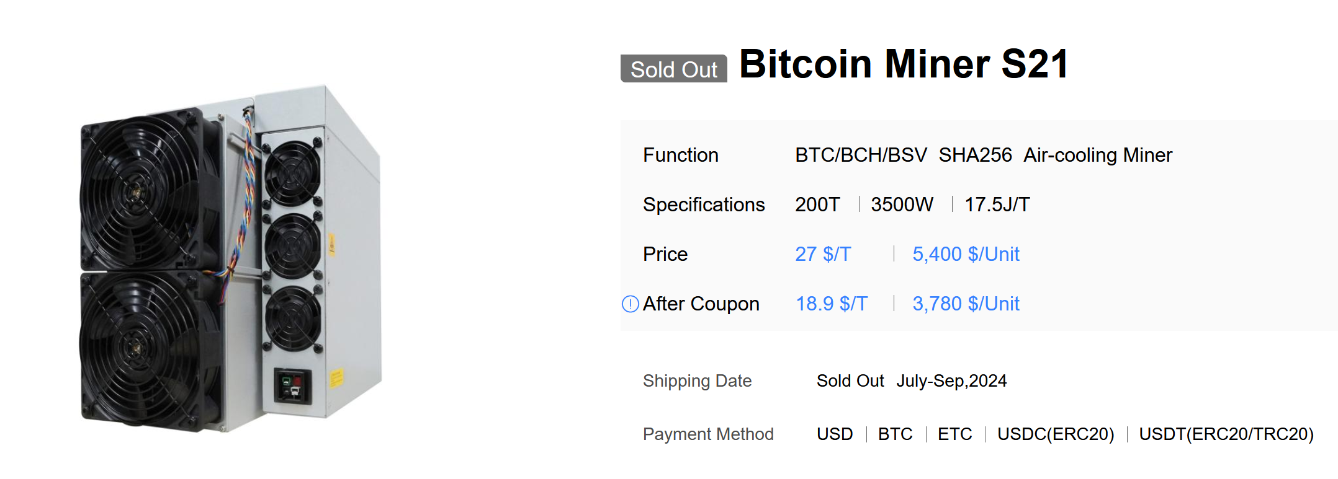

Slide 28
Transferring Money in the Account Model

Slide 29
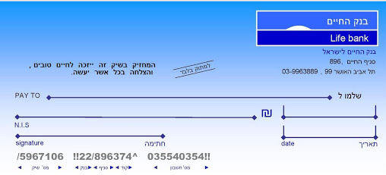
Transferring Money in the Account Model
Similar to cheque
Who is paid?
The amount to transfer
“Proof” of ownership
Who pays?

Slide 30
Account Model – Cheque Validity
We accept cheque if:
Payer’s signature is valid (matches the account owner).
Payer has enough money in the bank.
Deposited to the payee account.

Slide 31
Transferring Money in the Account Model
Who is paid?
The amount to transfer
“Proof” of ownership / identity
Who pays? (account number)
What is this for?
What is this for?
What is this for?

Slide 32
Transferring Money in the UTxO Model

Slide 33
Transactions
Abbreviated as “Tx”.
Cryptocurrency equivalent of cheques.
Transfer cryptocurrencies between parties.
Txs vary between cryptocurrencies.
We will cover Bitcoin Txs.

Slide 34
On-Chain Tx
Cryptocurrencies are (usually) distributed.
Everybody needs to know a Tx happened.
Txs are collected into blocks by miners.
Send Tx to all miners
Miners send blocks to everyone.
The blockchain is a log of all Txs

Slide 35
How do you “own” bitcoins?
Bitcoin’s ledger associates amounts of bitcoin with a “script”.
If you can satisfy the script, you can reassign the funds.
Funds are completely consumed.
Bitcoin’s Ledger (UTxO)
Transaction
0.6 BTC
PK2
CHECKSIG
1 BTC
PK1
CHECKSIG
SIG1
Output script
data
0.4 BTC
PK3
CHECKSIG
0.6 BTC
PK2
CHECKSIG
New outputs
0.4 BTC
PK3
CHECKSIG

Slide 36
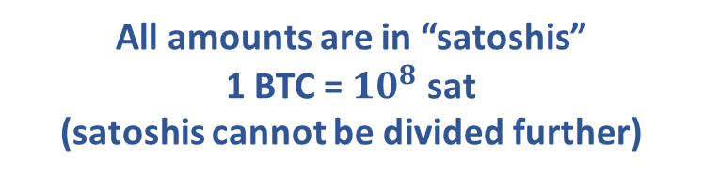
TX Structure
Tx 1
TxID1
OutInd1
ScriptSig1
600 sat
Script1
inputs
TxID2
OutInd2
ScriptSig2
outputs
200 sat
Script2
TxID3
OutInd3
ScriptSig3
Hash of input tx
Output index
Data necessary to make script “pass”
All amounts are in “satoshis”
1 BTC = $10^{8}$ sat
(satoshis cannot be divided further)

Slide 37
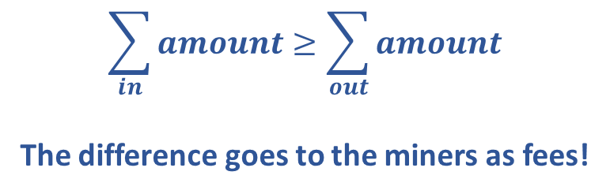
The Tx DAG (Direct Acyclic Graph)
Tx 1
100 sat
Script
SSig1
300 sat
Script
Tx 4
ScriptSig1
Tx 2
600 sat
Script
SSig1
ScriptSig2
100 sat
Script
200 sat
Script
ScriptSig3
SSig1
Tx 3
$$\sum_{in}{amount}≥\sum_{out}{amount}$$
The difference goes to the miners as fees!
SSig1
500 sat
Script
SSig1
200 sat
Script

Slide 38
The Tx DAG (Direct Acyclic Graph)
Tx 5
100 sat
Script
SSig1
Tx 4
300 sat
Script
SSig1
500 sat
Script
Conflicting!
SSig1
200 sat
Script
Tx 6
SSig1
100 sat
Script
SSig1

Slide 39
Tx Validity
All signatures are valid.
Spend UTxOs only.
Prevent input reuse by payer (double spend).
Prevent Tx reuse by payees (replay attack).
Outputs <= inputs.
Together with the UTxO rule, makes sure the payer has enough money to pay.
Difference is a fee given to miners.
Why not specify in advance the address of the miner?
More rules

Slide 40
UTxO
Unspent Transaction Outputs
For practical purposes nodes only hold the UTxO set in memory.
That’s all you need in order to validate new transactions
If a node has been offline, it reads the blockchain from the last block synchronized to update the UTxO.
Bitcoin’s Ledger (UTxO)
TxID
Ind
30 sat
Script
TxID
Ind
500 sat
Script
TxID
Ind
10 sat
Script
TxID
Ind
150 sat
Script
TxID
Ind
100 sat
Script

Slide 41

Digital Signatures
Integrity:
We might encounter a problem: internet communication might go through untrusted parties.
Alice
Bob

Slide 42


Digital Signatures - Integrity
TX 1
Output 1: Amount: 5 To: Mallory Output 2: Amount: 50 To: Bob
TX 1
Output 1: Amount: 50 To: Mallory Output 2: Amount: 5 To: Bob
Alice
Alice
Mallory
Bob
Bob

Slide 43
Digital Signatures - Authenticity
TX 1
Output 1: Amount: 500000000 To: Mallory From: Bob
Bob
Mallory

Slide 44
Digital Signatures
Cryptographic tool to verify authenticity and integrity of messages.
Hard to “correctly” sign messages without knowing some “secret”.
Modifying a signed message invalidates signature.
A valid signed message assures us that:
The signer created the message.
The message was not changed in transit.

Slide 45
Digital Signatures
Users have public and private keys.
Private key:
Secret.
Used to sign messages.
Very hard to forge a signature without it.
Public key:
Can be shared.
Used to verify signed messages are valid.
Very hard to extract private key from it.

Slide 46
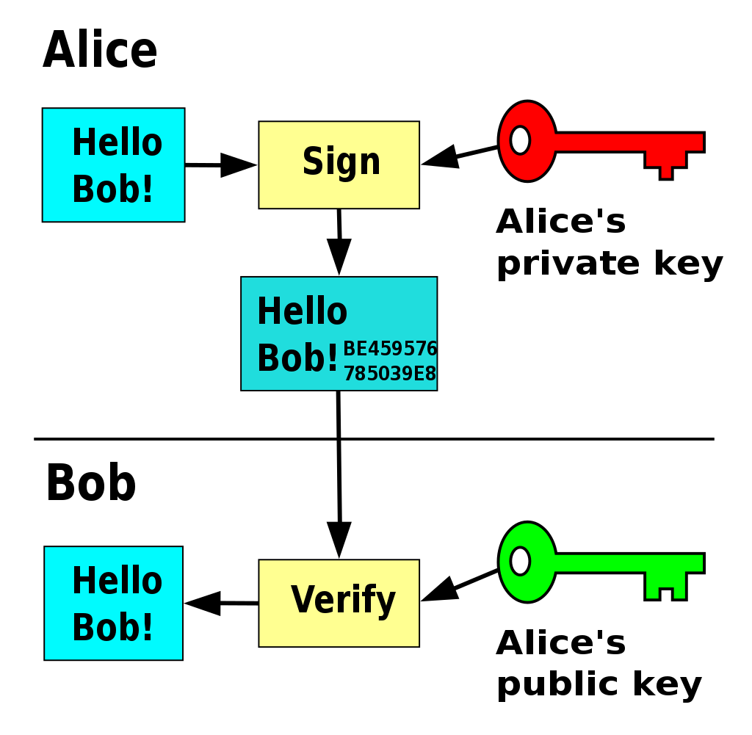
Digital Signatures - Example
Source: Wikipedia

Slide 47
Digital Signatures
How to prevent Tx modification? (malleability)
Sign the entire Tx. Can we really sign the whole thing?
Notes:
We sign specific parts of the tx, which reduces computational overhead

Slide 48
Identity and Anonymity
Users can generate a new public, private key pair for every Tx.
Pseudonymous.
Money can still be tracked!
More on that later in the course

Slide 49
Bitcoin script (stack based)
Bitcoin script is expressive but not Turing complete. See here: https://en.bitcoin.it/wiki/Script
The language is stack based:
Script: 1 2 ADD
Execution:
An online simulator https://siminchen.github.io/bitcoinIDE/build/editor.html
2
3
1

Slide 50
Tx Malleability attack
The signature is part of the transaction.
The signature can’t sign itself – parts of the script could be removed and only some other parts are signed.
Tx malleability allowed you to have an equivalent Tx (with the same end result) but with a different hash.
This was exploited to steal from exchanges.
How?
Signature malleability also an issue
Also need to consider non-deterministic sigs

Slide 51
P2PKH (Pay-to-Pub-Key-Hash)
The ”classic” bitcoin script did not include a pubkey.
Why?
Instead, it gave the hash of a pubkey
So how are signatures checked?
ScriptPubKey = OP_DUP OP_HASH160 <Public KeyHash> OP_EQUAL OP_VERIFY OP_CHECKSIG
ScriptSig = <Signature> <Public Key>
What happens on the stack?
Notes:
Instead of pubkey we use “addresses” (shorter than pubkey)

Slide 52
An Actual Tx
"txid": "70549c380266289b04fabcc95ab999f795758d52568a8802fbb7330085a5a727",
"hash": "70549c380266289b04fabcc95ab999f795758d52568a8802fbb7330085a5a727",
"version": 2, "size": 190, "vsize": 190, "weight": 760, "locktime": 0,
"vin": [{
"txid": "bb56ffd771aab3e30220cdc65bd529bdc34a9f6af6710f32f7ba3084f0ebab0f",
"vout": 10,
"scriptSig": {…},
"sequence": 4294967295
}],
"vout": [{
"value": 0.04230611,
"n": 0,
"scriptPubKey": {
"asm": "OP_HASH160 a1bcc4805c6f7da1ac1937405d89424a9f99f376 OP_EQUAL",
"hex": "a914a1bcc4805c6f7da1ac1937405d89424a9f99f37687",
"reqSigs": 1,
"type": "scripthash",
"addresses": ["3GSCrEJJVN6CMophTsy797dfxsQJ4gk812"]
}
}]

Slide 53
Txs & Miners

Slide 54
Coinbase Tx
A special transaction that “creates money”.
An incentive to mine.
Has a single input that doesn’t spend a previous Tx.
Can be anything: “The Times 03/Jan/2009 Chancellor on brink of second bailout for banks”
Added by miners to their blocks.
The amount is regulated by consensus rules.
Start at 50 BTC + fees.
Halved every 210,000 blocks. (last halving was in April 2024)
Now: 3.125 BTC + fees.

Slide 55
Mempool
Short for Memory Pool.
Maintained by miners, individually.
Data structure that stores Txs that are:
Valid
Not included in any block yet.
Miners can pick Txs with highest fees.
They don’t have to.
Can mine “empty” blocks.

Slide 56
ReOrgs
Short for re-organization.
Adoption of a conflicting “longer” chain.
Miners maintain a set of all UTxOs.
ReOrgs require updating both:
UTxO set.
Mempool.
Hash
Hash
Hash
Hash
Hash

